Slide 1
Bioinformatics for Adaptation Genomics Day 3: Inference on evolutionary signal from SNP data
Detecting signatures of natural selection
from NGS data (part 1/2)
Matteo Fumagalli
March 2nd 2016

Slide 2
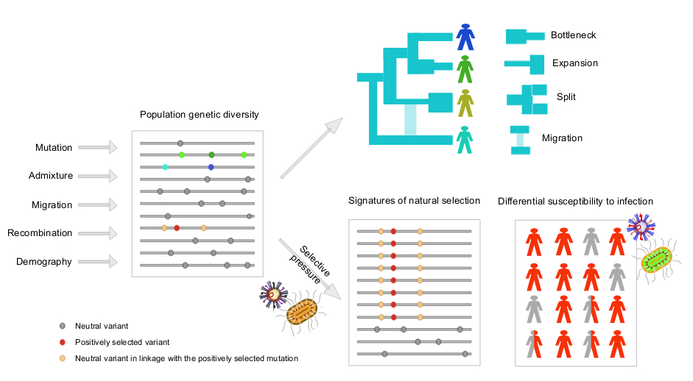
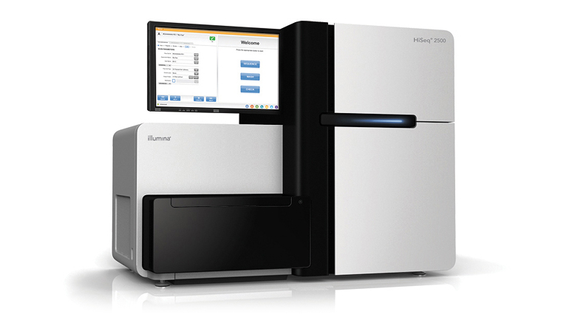
Bioinformatics for Adaptation
Notes:
I am a computational biologist interested in developing methods for the analysis of DNA data for population genetic purposes, both for reconstructing the species demography and for detecting signatures of natural selection.

Slide 3
Outline
Brief introduction to natural selection
Inferring selection at the intra-species level
Genetic differentiation
Haplotype variation
Model-based approaches
Testing for significance
Inferring selection at the inter-species level
Detecting selection from low-depth sequencing data
Notes:
Broad overview on adaptation to environments

Slide 4
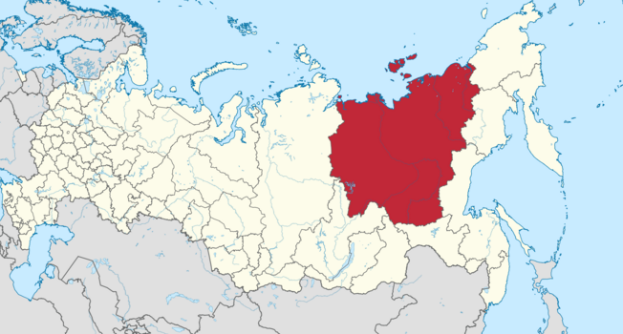
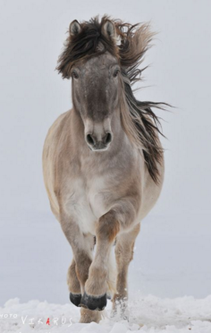
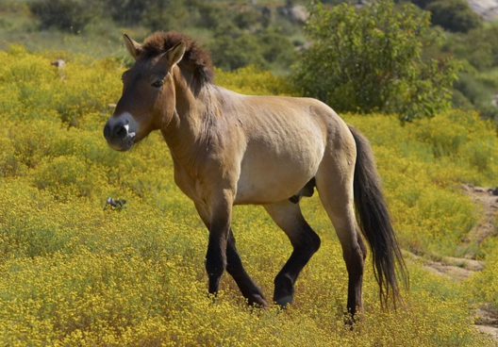
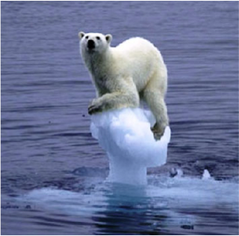
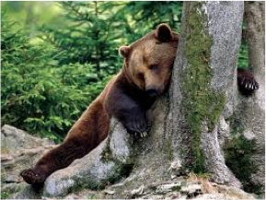
Adaptation & Phenotypes
Notes:
Then polar bears + brown bears
Again striking difference in phenotypes
image yakutian horse + image siberia + domestic horse
Say different phenotypoe
Then skin pigmen in humans
Even within the same species
And this is related to adaptation to environments, they live in diff environments

Slide 5
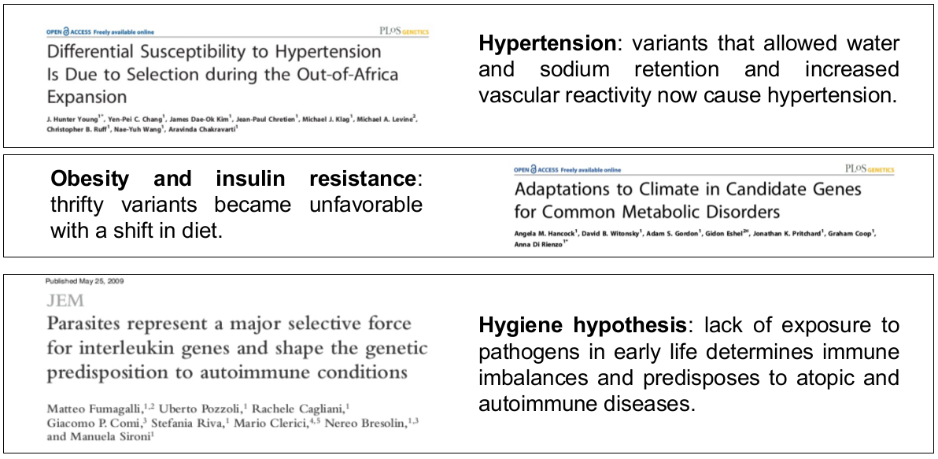
Relevance to human health
Why do African Americans suffer from a higher incidence of hypertension?
Notes:
Recent studies have identified genes related to skin pigmentation, metabolic traits or immune defense targeted by natural selection in the human genome.
Twofold meaning: here stress functionality… and give one example of disease-related, how evo inference caught a disease snp

Slide 6
Relevance to human health
Why is there any increase of obesity-related disorders is some countries?
Notes:
Recent studies have identified genes related to skin pigmentation, metabolic traits or immune defense targeted by natural selection in the human genome.
Twofold meaning: here stress functionality… and give one example of disease-related, how evo inference caught a disease snp

Slide 7
Relevance to human health
Why do Northern Europeans experience a dramatic susceptibility to autoimmune conditions?
Notes:
Recent studies have identified genes related to skin pigmentation, metabolic traits or immune defense targeted by natural selection in the human genome.
Twofold meaning: here stress functionality… and give one example of disease-related, how evo inference caught a disease snp

Slide 8

Relevance to human health
Evolutionary medicine
Notes:
Recent studies have identified genes related to skin pigmentation, metabolic traits or immune defense targeted by natural selection in the human genome.
Twofold meaning: here stress functionality… and give one example of disease-related, how evo inference caught a disease snp

Slide 9

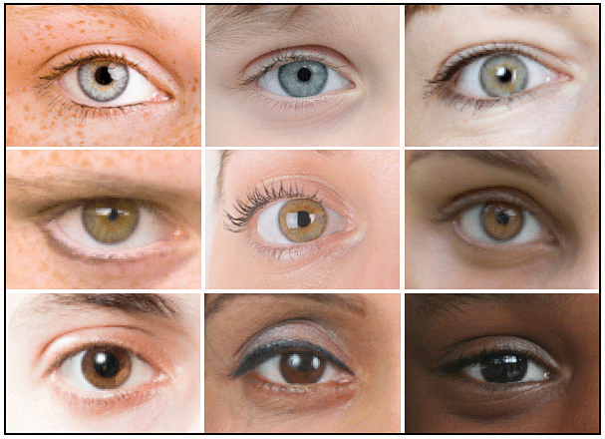
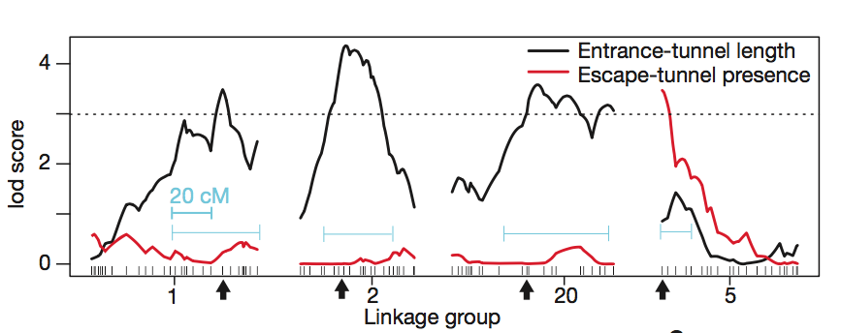
The genetic basis of phenotype variation
Genome-wide association studies (GWAS)
- QTL mapping
Length
Escape tunnel
Weber et al., 2013
Notes:
Even within the same species
How to get these? Thorugh GWAS!

Slide 10
Natural selection
Heritable traits that increase the fitness of the become more common.
Mutations arise randomly and evolve according to their effect on the fitness of the carrier
Neutrality
1
Fixation
Frequency in the population
Polymorphisms
0
t=T
Removal
t=present
Time
Notes:
Yes, but lines are built up step by step
So a strategy to understand molecular basis of adaptation is to look for sign of selection

Slide 11

Natural selection
Heritable traits that increase the fitness of the become more common.
Mutations arise randomly and evolve according to their effect on the fitness of the carrier
Negative selection
1
Frequency in the population
Polymorphism
0
t=T
(quick) Removal
t=present
Time
Notes:
Yes, but lines are built up step by step
So a strategy to understand molecular basis of adaptation is to look for sign of selection

Slide 12

Natural selection
Heritable traits that increase the fitness of the become more common.
Mutations arise randomly and evolve according to their effect on the fitness of the carrier
Positive selection
t=Selective pressure
1
(quick) Fixation
Frequency in the population
Polymorphism
0
t=T
(quick) Removal
t=present
Time
Notes:
Yes, but lines are built up step by step
So a strategy to understand molecular basis of adaptation is to look for sign of selection

Slide 13

Natural selection
Heritable traits that increase the fitness of the become more common.
Mutations arise randomly and evolve according to their effect on the fitness of the carrier
Balancing selection
t=Selective pressure
1
(quick) Fixation
Frequency in the population
Balanced
polymorphism
Polymorphism
0
t=T
(quick) Removal
t=present
Time
Notes:
Yes, but lines are built up step by step
So a strategy to understand molecular basis of adaptation is to look for sign of selection

Slide 14
Natural selection
Heritable traits that increase the fitness of the become more common.
Mutations arise randomly and evolve according to their effect on the fitness of the carrier
Sites targeted by natural selection are likely to harbour functionality
Natural selection
t=Selective pressure
1
(quick) Fixation
Frequency in the population
Balanced
polymorphism
Polymorphism
0
t=T
(quick) Removal
t=present
Time
Notes:
Yes, but lines are built up step by step
So a strategy to understand molecular basis of adaptation is to look for sign of selection

Slide 15
Outline
Brief introduction to natural selection
Modes of selection
Inferring selection at the intra-species level
Genetic differentiation
Haplotype variation
Model-based approaches
Testing for significance
Inferring selection at the inter-species level
Detecting selection from low-depth sequencing data
Notes:
Broad overview on adaptation to environments

Slide 16

Methods to infer selection
within-species:
Micro-evolutionary events between populations, local adaptation
Notes:
And here first show (nielse 2005) the molecular effect of natural selection, then say methods

Slide 17
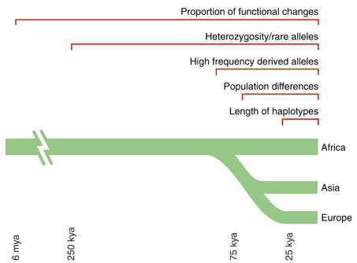
Methods to infer recent selection
Sabeti et al. 2006 Science

Slide 18
Methods to infer recent selection
Sabeti et al. 2006 Science

Slide 19
Allele frequency differentiation
Time
Present time

Slide 20
Allele frequency differentiation
Time
Separation
Environmental change
Present time

Slide 21
Allele frequency differentiation
Time
Separation
Environmental change
Onset of beneficial
mutation
Present time

Slide 22
Allele frequency differentiation
Time
Separation
Environmental change
Onset of beneficial
mutation
Present time

Slide 23
Allele frequency differentiation
Time
Separation
Environmental change
Onset of beneficial
mutation
Present time
Notes:
How can we quantify this?

Slide 24
F_{ST}
Common measure for quantifying population subdivision.
H_{B}: between populations
H_{W}: average within populations
if H_{W}=0 then F_{ST}=1
if H_{B}=0 then F_{ST}=0
F_{ST} = H_{B} / (H_{W} + H_{B})

Slide 25
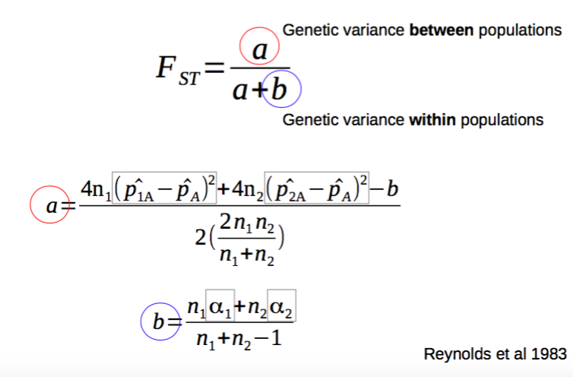
F_{ST}
F_{ST} can be either considered a statistic or a parameter
Method-of-moments estimator
(depends on sample allele frequencies and sample size)
- Parameter of a distribution (e.g. a Beta-Binomial)

Slide 26
Haplotype-based F_{ST}
F_{ST} based on haplotype differentiation between populations
F_{ST} = 1 – (H_{W} / H_{B})
A
B
C
Within populations
Between populations
What is the variation within populations?
e.g. A vs B
The differ by 1 site
D
E
F
As defined by Eq. 3 in Hudson, Slatkin and Maddison 1992
Notes:
Here develop our own estimator based on haplo differences

Slide 27
Haplotype-based F_{ST}
F_{ST} = 1 – (H_{W} / H_{B})
A
B
C
Within populations
Between populations
What is the variation within populations?
A | B
A | C
B | C
Mean=?
D
E
F
D | E
D | F
E | F
Mean=?
H_{W} is the average within-populations: ?
Notes:
Here develop our own estimator based on haplo differences

Slide 28
Haplotype-based F_{ST}
F_{ST} = 1 – (H_{W} / H_{B})
A
B
C
Within populations
Between populations
What is the variation within populations?
A | B | 1
A | C | 2
B | C | 1
Mean=4/3
D
E
F
D | E | 0
D | F | 0
E | F | 0
Mean=0/3
H_{W} is the average within-populations: (4/3+0/3)/2=2/3
Notes:
Here develop our own estimator based on haplo differences

Slide 29
Haplotype-based F_{ST}
F_{ST} = 1 – (H_{W} / H_{B})
Within populations
Between populations
A
B
C
What is the variation between populations?
A | D | 0
A | E | 0
A | F | 0
B | D | 1
B | E | 1
B | F | 1
C | D | 2
C | E | 2
C | F | 2
D
E
F
Mean=9/9
H_{B} is the average between-populations: 9/9=1
Notes:
Here develop our own estimator based on haplo differences

Slide 30
Haplotype-based F_{ST}
F_{ST} based on haplotype differentiation between populations
A
B
C
F_{ST} = 1 – (H_{W} / H_{B}) = 1 – ((2/3)/1) = 1/3 ~ 0.33
D
E
F
Notes:
Here develop our own estimator based on haplo differences

Slide 31
Haplotype-based F_{ST}
F_{ST} based on haplotype differentiation between populations
A
B
C
F_{ST} = 1 – (H_{W} / H_{B}) = 1 – ((2/3)/1) = 1/3 ~ 0.33
D
E
F
F_{ST} = 1 – (?/?) = ?
Notes:
Here develop our own estimator based on haplo differences

Slide 32
Haplotype-based F_{ST}
F_{ST} based on haplotype differentiation between populations
A
B
C
F_{ST} = 1 – (H_{W} / H_{B}) = 1 – ((2/3)/1) = 1/3 ~ 0.33
D
E
F
F_{ST} = 0.75
Sample size matters!
Notes:
Here develop our own estimator based on haplo differences

Slide 33
Allele frequency differentiation
From standing variation
Difference in
allele frequency
Time

Slide 34
Allele frequency differentiation
With migration
Difference in
allele frequency
Time

Slide 35
Migration rates
Two populations may be separated but occasionally migrants may move and exchange genetic material.
1
m
F_{ST}
0
m
m = probability that an individual from one population is replaced with an individual from the other (per individual, per generation)

Slide 36
Allele frequency differentiation
With recent divergence
Difference in
allele frequency
Time

Slide 37
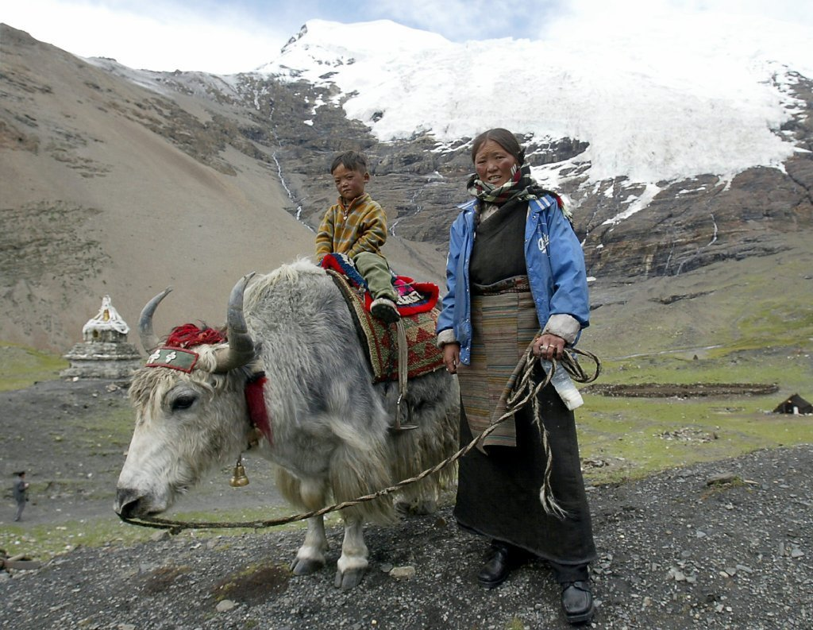
The case of Tibetans
Adaptation to high altitude

Slide 38


Selection in Tibetans
T
C
F_{ST}(T-C)

Slide 39
Selection in Tibetans
T
C
T(T-A)
T(C-A)
A
F_{ST}(T-C)~T(T-A-C)

Slide 40
Selection in Tibetans
F_{ST}(T-C)~T(T-A-C)
T
T(T-A)
C
T(C-A)
A

Slide 41
Selection in Tibetans
F_{ST}(T-C)~T(T-A-C)
C
T(C-A)
T
T(T-A)
A

Slide 42

Selection in Tibetans
F_{ST}(T-C)~T(T-A-C)
T
C
T(T-A)
A
T(C-A)
T(E-A)
E

Slide 43

Selection in Tibetans
T
C
T(T-A)
A
T(C-A)
T(T-A-C)=-log(1-F_{ST}(T-C))
T(E-A)
E
T(T-A)?

Slide 44
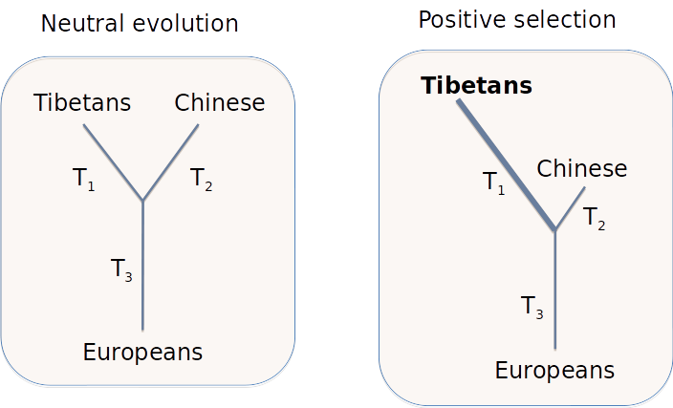
Population Branch Statistic
Population Branch Statistic (PBS) = (T₁₂ + T₁₃ - T₂₃)/2
Yi et al. Science 2010

Slide 45
Adaptation to environments
Detect putative loci targeted by natural selection showing extreme or unusual values of statistics based on population genetic differentiation.
But:
1) power to detect a selective event only if the process is recent or strong enough or the beneficial allele is nearly fixed to leave
a clear footprint;
2) unable to underline the environmental factor (pathogens, diet or climate) that acted as selective pressure.

Slide 46
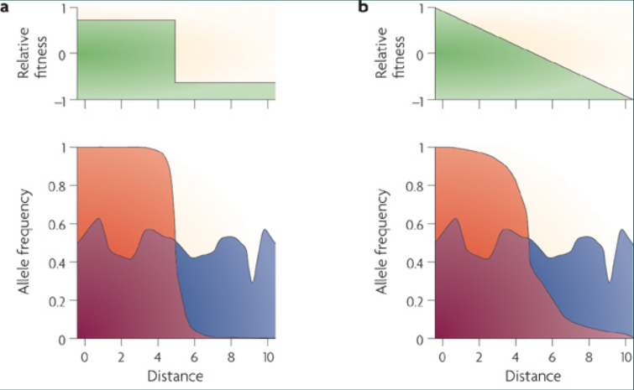
Spatial variation
Novembre and Di Rienzo. Nat Rev Genet. 2009

Slide 47
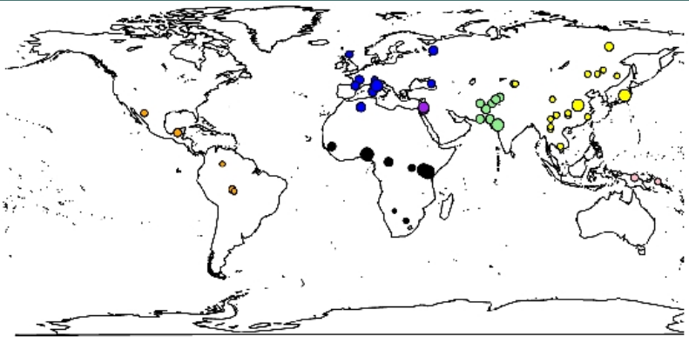
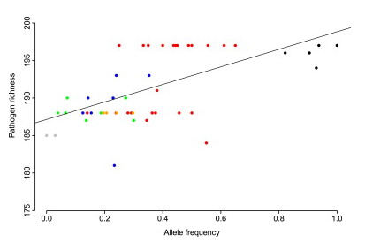
Correlations
Worldwide samples
Ecological variables
Mantel correlations
Bayesian methods (BayEnv)
Mixed models (LFMM)
Sironi and Clerici. Microbes Infect. 2010

Slide 48
Methods to infer recent selection
Sabeti et al. 2006 Science

Slide 49
Positive selection: effect on haplotypes
t<T_{sel}
Notes:
Under neutrality, each haplotype will accumulate it own mutations

Slide 50
Positive selection: effect on haplotypes
t<T_{sel}
t=T_{sel}
Notes:
Under neutrality, each haplotype will accumulate it own mutations

Slide 51
Positive selection: effect on haplotypes
t<T_{sel}
t=T_{sel}
t>T_{sel}
Notes:
Under neutrality, each haplotype will accumulate it own mutations

Slide 52


Positive selection: effect on haplotypes
t<T_{sel}
t=T_{sel}
t>T_{sel}
t>>T_{sel}
Selective sweep
Genetic hitchhiking
Adaptation
Notes:
Selective sweep: the beneficial allele is driven to fixation
Partial sweep: when the beneficial allele hasn’t reached fixation yet.

Slide 53
Positive selection
t<T_{sel}
…
t>>T_{sel}
?
Notes:
Reduced number of polymorphisms, but need to derive some indexes of nucleotide diversity taking into account the sample size for instance

Slide 54
Positive selection
t<T_{sel}
…
t>>T_{sel}
- Reduction of polymorphisms levels
(e.g. from 7 to 5 SNPs)
Notes:
Reduced number of polymorphisms, but need to derive some indexes of nucleotide diversity taking into account the sample size for instance

Slide 55
Positive selection
t<T_{sel}
…
t>>T_{sel}
- Reduction of polymorphisms levels
(e.g. from 7 to 5 SNPs)
Nucleotide diversity index: Watterson’s Theta (1975)
with K SNPs and n chromosomes
Notes:
Under neutrality, each haplotype will accumulate it own mutations

Slide 56
Positive selection
t<T_{sel}
…
t>>T_{sel}
Reduction of polymorphisms levels (Theta)
?
Notes:
Not only the number of SNPs but their frequency as well

Slide 57
Positive selection
t<T_{sel}
…
t>>T_{sel}
Reduction of polymorphisms levels (Theta)
Excess of low-frequency variants
Nucleotide diversity index: average pairwise nucleotide differences (Pi)
with k_{i,j} equal to the number of nucleotide differences between sequences i and j
Notes:
Not only the number of SNPs but their frequency as well

Slide 58
Positive selection
t<T_{sel}
…
t>>T_{sel}
Reduction of polymorphisms levels (Theta)
Excess of low-frequency variants (Pi)
Under neutrality, Theta and Pi are expected to be the same.
Tajima’s D measures their difference.
D<0 is suggestive of an excess of low-frequency variants
Notes:
Not only the number of SNPs but their frequency as well

Slide 59
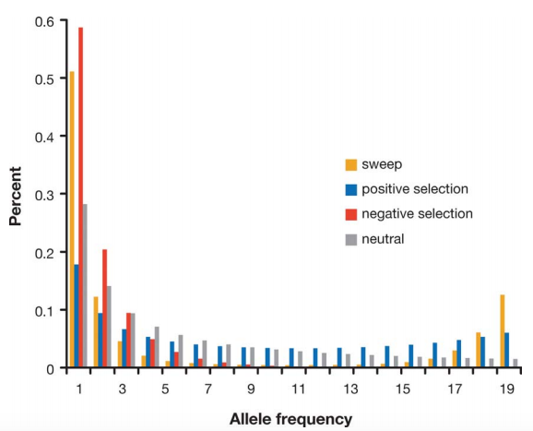
The importance of being… The Site Frequency Spectrum
Notes:
General slide on the site frequency spectrum
Say differentiation between sweep and negative selection? Look at fay and wu’sh?

Slide 60
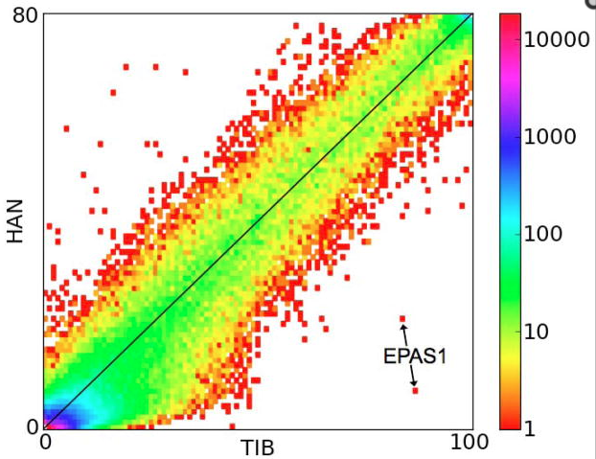
2D-SFS
Chinese
Tibetans
Yi et al. Science 2010

Slide 61
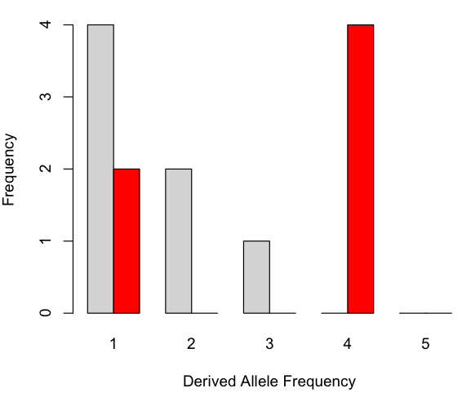
The importance of being… The Site Frequency Spectrum
t<T_{sel}
…
t>>T_{sel}
Notes:
Show the site frequency spectrum here for these cases

Slide 62
The importance of being… The Site Frequency Spectrum
t<T_{sel}
…
t>>T_{sel}
Tajima’s D?
~0.33=1/3
= 10, the number of comparisons you need to make
Notes:
Show the site frequency spectrum here for these cases

Slide 63
The importance of being… The Site Frequency Spectrum
t<T_{sel}
…
t>>T_{sel}
K=5
a_{n}=1/1 + 1/2 + 1/3 + 1/4=(12+6+4+3)/12=25/12
Theta=5/(25/12)=12/5
Pi=(5+5+5+5+0+0+0+0+0+0)/10=20/10=2
sd(D)=1/3
D=(2-12/5)/(1/3)=((10-12)/5)*3=-6/5=-1.2
How to distinguish between positive and negative selection?
D<0
Notes:
Show the site frequency spectrum here for these cases

Slide 64
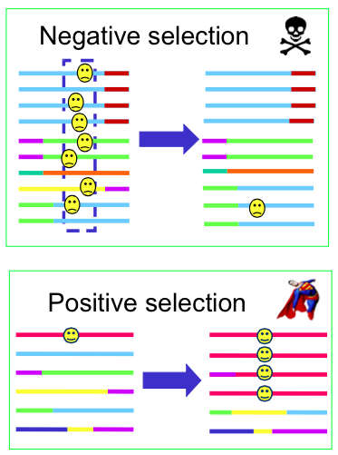
Positive vs. negative selection
Excess of low-frequency variants (Tajima’s D<0, Fu and Li’s D/F<0)
Extended Linkage Disequilibrium
Excess of high-frequency derived alleles (Fay and Wu’s H)

Slide 65
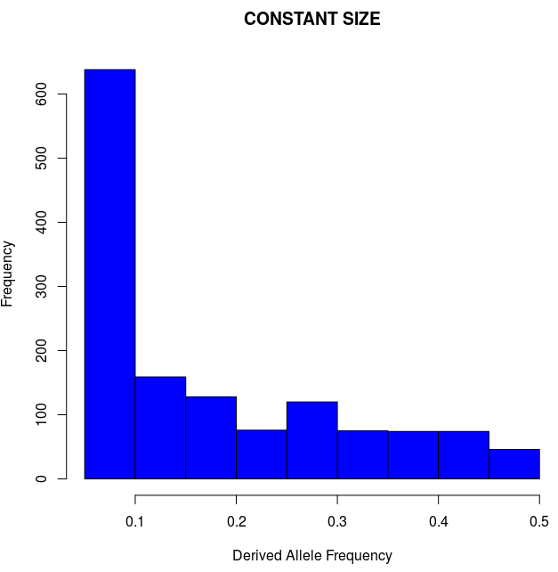
Demography matters?
n=20; L=500kbp; no selection
K=1,390
Theta=392
Pi=390
D=-0.016
Minor Allele Frequency
Notes:
Here run some simulations assuming expansion (Africans?)… and show tajima’s D negative.
Draw together some conclusions on the effect of pop size expansion?
Then introduce 2 ways of correcting for this, empirical and simulations
Then show what D>0 means? Balancing selection and introduce it.

Slide 66
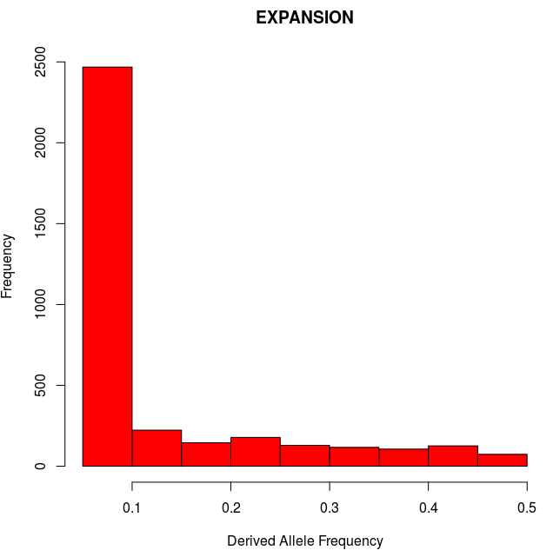
Demography matters?
n=20; L=500kbp; no selection
n=20; L=500kbp; no selection
K=1,390
Theta=392
Pi=390
D=-0.016
K=3,566
Theta=1,005
Pi=732
D=-1.14
Minor Allele Frequency
Minor Allele Frequency
Notes:
Here run some simulations assuming expansion (Africans?)… and show tajima’s D negative.
Draw together some conclusions on the effect of pop size expansion?
Then introduce 2 ways of correcting for this, empirical and simulations
Then show what D>0 means? Balancing selection and introduce it.

Slide 67
Demography matters!
n=20; L=500kbp; no selection
n=20; L=500kbp; no selection
K=1,390
Theta=392
Pi=390
D=-0.016
K=3,566
Theta=1,005
Pi=732
D=-1.14
Minor Allele Frequency
Minor Allele Frequency
Notes:
Here run some simulations assuming expansion (Africans?)… and show tajima’s D negative.
Draw together some conclusions on the effect of pop size expansion?
Then introduce 2 ways of correcting for this, empirical and simulations
Then show what D>0 means? Balancing selection and introduce it.

Slide 68
The genetic effects of population size changes
Present
Past
Expansion:
“More” mutations
Excess of low-frequency variants

Slide 69
Demography matters!
n=20; L=500kbp; no selection
n=20; L=500kbp; no selection
K=1,390
Theta=392
Pi=390
D=-0.016
K=3,566
Theta=1,005
Pi=732
D=-1.14
Minor Allele Frequency
Minor Allele Frequency
Excess of segregating sites
Excess of low-frequency variants
SFS-derived summary statistics may fail to distinguish between the effects of demography and selection
Notes:
Here run some simulations assuming expansion (Africans?)… and show tajima’s D negative.
Draw together some conclusions on the effect of pop size expansion?
Then introduce 2 ways of correcting for this, empirical and simulations
Then show what D>0 means? Balancing selection and introduce it.

Slide 70
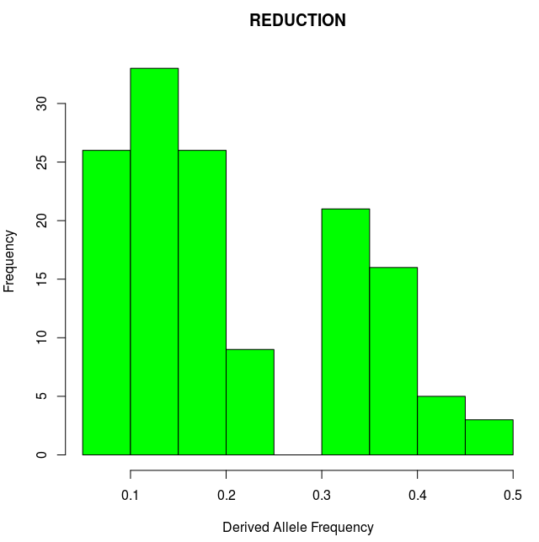
Demography matters?
n=20; L=500kbp; no selection
n=20; L=500kbp; no selection
K=1,390
Theta=392
Pi=390
D=-0.016
K=139
Theta=39
Pi=47
D=0.83
Minor Allele Frequency
Minor Allele Frequency
Notes:
Here run some simulations assuming expansion (Africans?)… and show tajima’s D negative.
Draw together some conclusions on the effect of pop size expansion?
Then introduce 2 ways of correcting for this, empirical and simulations
Then show what D>0 means? Balancing selection and introduce it.

Slide 71
Demography matters!
n=20; L=500kbp; no selection
n=20; L=500kbp; no selection
K=1,390
Theta=392
Pi=390
D=-0.016
K=139
Theta=39
Pi=47
D=0.83
Minor Allele Frequency
Minor Allele Frequency
Notes:
Here run some simulations assuming expansion (Africans?)… and show tajima’s D negative.
Draw together some conclusions on the effect of pop size expansion?
Then introduce 2 ways of correcting for this, empirical and simulations
Then show what D>0 means? Balancing selection and introduce it.

Slide 72
The genetic effects of population size changes
Past
Present
Bottleneck event: drastic reduction in size followed by recovery:
Depletion of rare variants
Excess of common variants

Slide 73
Demography matters!
n=20; L=500kbp; no selection
n=20; L=500kbp; no selection
K=1,390
Theta=392
Pi=390
D=-0.016
K=139
Theta=39
Pi=47
D=0.83
Minor Allele Frequency
Minor Allele Frequency
Depletion of segregating sites
Excess of intermediate-frequency variants
SFS-derived summary statistics may fail to distinguish between the effects of demography and selection
?
Notes:
Here run some simulations assuming expansion (Africans?)… and show tajima’s D negative.
Draw together some conclusions on the effect of pop size expansion?
Then introduce 2 ways of correcting for this, empirical and simulations
Then show what D>0 means? Balancing selection and introduce it.

Slide 74
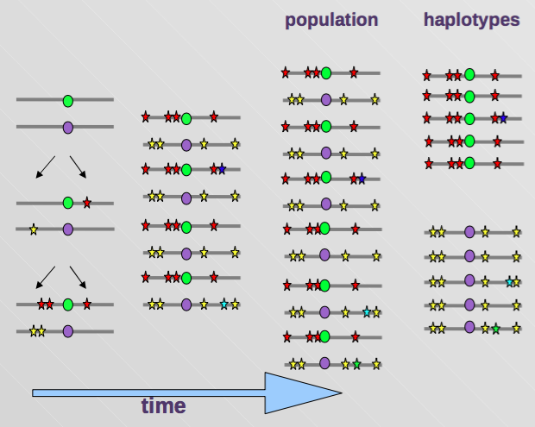
Balancing selection
The process whereby genetic variability is maintained in the population due to selection
Features:
High nucleotide diversity
Excess of intermediate frequency alleles
Excess of polymorphisms compared to interspecies divergence
More difficult to detect (shorter genomic extent)
Overdominance (the heterozygote has an advantage)
Frequency dependence (an advantage is conferred by a rare feature)
Environmental adaptation (different alleles are advantageous in different environments)
Notes:
Balancing selection

Slide 75
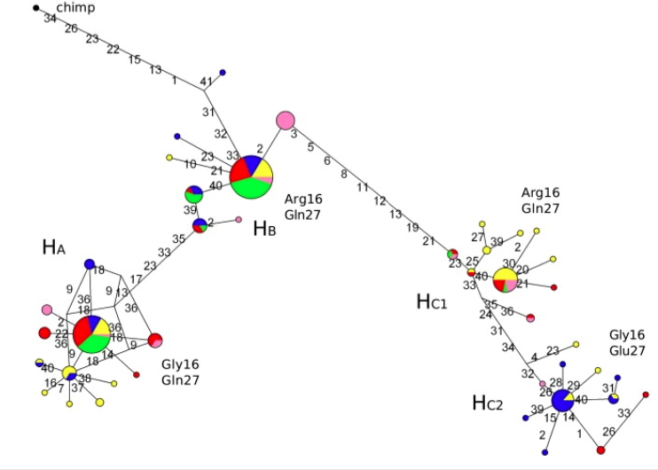
Balancing selection
Common haplotypes separated by deep branches
(deep time to the most common recent ancestor)
Confounding factor: ancient population structure
Notes:
Say deep TMRCA
And if rare?
Mention confoudning effect of ancient pop structure?

Slide 76
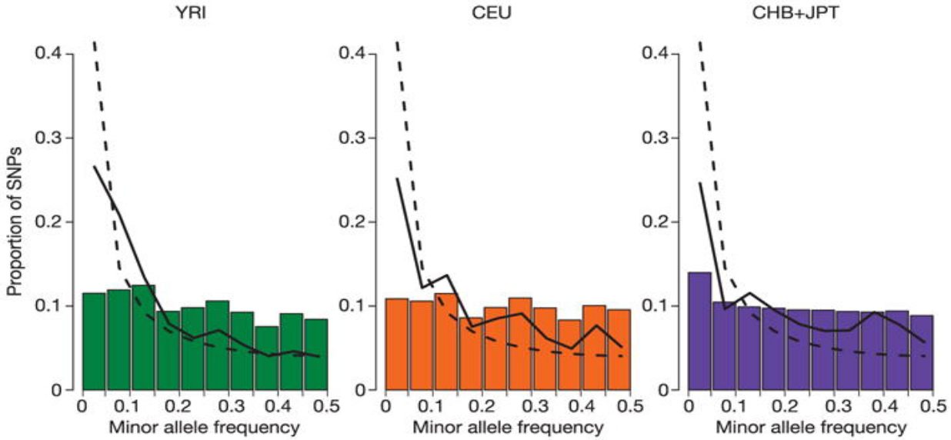
Experimental design matters?
The effect of ascertainment bias
Deficiency of low-frequency variants
HapMap Consortium. Nature 2005
Notes:
Another bias that may mimic balancing selection (mention also ancient pop structure)

Slide 77
How to take neutral confounding factors into account?
Under constant population size:
Tajima’s D
2
.
.
.
.
.
.
.
.
.
.
.
.
.
.
.
E[D]~0
0
-2
Genome / Chromosome
Notes:
Here run some simulations assuming expansion (Africans?)… and show tajima’s D negative.
Draw together some conclusions on the effect of pop size expansion?
Then introduce 2 ways of correcting for this, empirical and simulations
Then show what D>0 means? Balancing selection and introduce it.

Slide 78
How to take neutral confounding factors into account?
Under expanding population size:
Tajima’s D
2
0
.
.
.
.
.
.
.
.
.
.
.
.
.
.
.
E[D]<0
-2
Genome / Chromosome
Notes:
Here run some simulations assuming expansion (Africans?)… and show tajima’s D negative.
Draw together some conclusions on the effect of pop size expansion?
Then introduce 2 ways of correcting for this, empirical and simulations
Then show what D>0 means? Balancing selection and introduce it.

Slide 79
How to take neutral confounding factors into account?
Under expanding population size and positive selection:
Tajima’s D
2
0
.
.
.
.
.
.
.
.
.
.
.
.
.
.
E[D]<0
.
-2
Genome / Chromosome
Demography affects all loci equally, while selection changes local patterns
Notes:
Here run some simulations assuming expansion (Africans?)… and show tajima’s D negative.
Draw together some conclusions on the effect of pop size expansion?
Then introduce 2 ways of correcting for this, empirical and simulations
Then show what D>0 means? Balancing selection and introduce it.

Slide 80
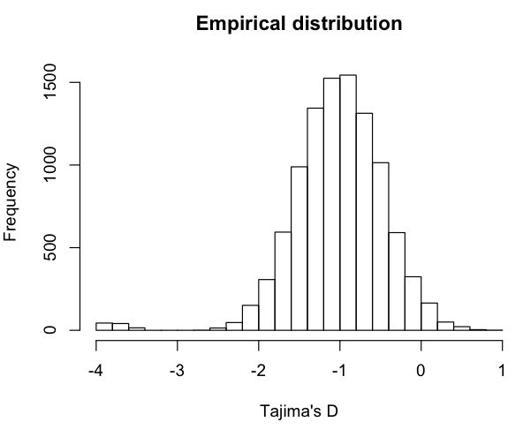
Outlier approach
Tajima’s D
2
0
.
.
.
.
.
.
.
.
.
.
.
.
.
.
E[D]<0
.
-2
Genome / Chromosome
Assign empirical p-values
(ranked percentiles)
Notes:
Here run some simulations assuming expansion (Africans?)… and show tajima’s D negative.
Draw together some conclusions on the effect of pop size expansion?
Then introduce 2 ways of correcting for this, empirical and simulations
Then show what D>0 means? Balancing selection and introduce it.

Slide 81
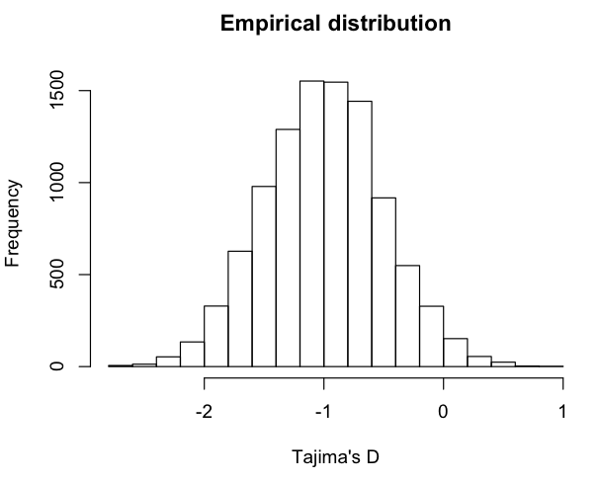
Outlier approach
Tajima’s D
2
0
.
.
.
.
.
.
.
.
.
.
.
.
.
.
E[D]<0
.
-2
Genome / Chromosome
?
Assign empirical p-values
(ranked percentiles)
Notes:
Gene ontology or pathway enrichment analyses, you will always get some outliers
An alternative is to use a demographic model

Slide 82
How to take neutral confounding factors into account?
Under expanding population size and positive selection:
Tajima’s D
2
0
.
.
.
.
.
.
.
.
.
.
.
.
.
.
E[D]<0
.
-2
Genome / Chromosome
Demography affects all loci equally, while selection changes local patterns
What should we do if we don’t have genome-wide data?
Notes:
Here run some simulations assuming expansion (Africans?)… and show tajima’s D negative.
Draw together some conclusions on the effect of pop size expansion?
Then introduce 2 ways of correcting for this, empirical and simulations
Then show what D>0 means? Balancing selection and introduce it.

Slide 83
How to take neutral confounding factors into account?
Under expanding population size and positive selection:
Tajima’s D
2
But we know what’s driving the expected distribution
0
E[D]<0
.
-2
Genome / Chromosome
Demography affects all loci equally, while selection changes local patterns
What should we do if we don’t have genome-wide data?
Notes:
Here run some simulations assuming expansion (Africans?)… and show tajima’s D negative.
Draw together some conclusions on the effect of pop size expansion?
Then introduce 2 ways of correcting for this, empirical and simulations
Then show what D>0 means? Balancing selection and introduce it.

Slide 84
Simulations-based approach
Tajima’s D
2
0
E[D]<0
.
-2
Genome / Chromosome
Known demographic model
N0
T
N1
N1
Notes:
Here run some simulations assuming expansion (Africans?)… and show tajima’s D negative.
Draw together some conclusions on the effect of pop size expansion?
Then introduce 2 ways of correcting for this, empirical and simulations
Then show what D>0 means? Balancing selection and introduce it.

Slide 85
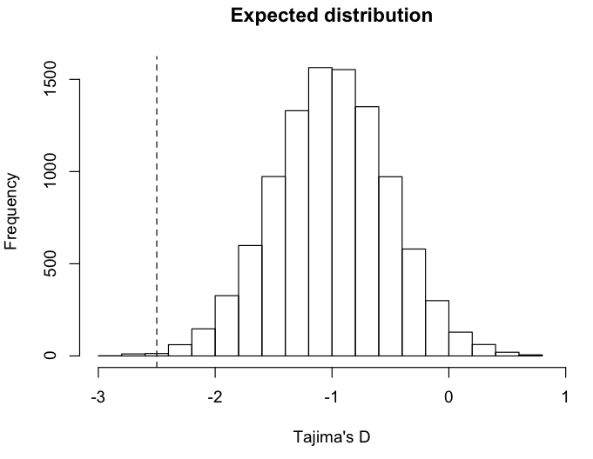
Simulations-based approach
Tajima’s D
2
0
E[D]<0
.
-2
Assign p-values
(based on ranked percentile of observed value)
Genome / Chromosome
Known demographic model
N0
T
N1
N1
Notes:
Here run some simulations assuming expansion (Africans?)… and show tajima’s D negative.
Draw together some conclusions on the effect of pop size expansion?
Then introduce 2 ways of correcting for this, empirical and simulations
Then show what D>0 means? Balancing selection and introduce it.

Slide 86
Model-based approaches
Expected distribution is derived from analytical solutions or fitted from observed data
Example: SweepFinder
The spatial patterns of fixed mutations and segregating sites with their frequencies is modeled using theoretical expectations. A (composite) likelihood ratio test is performed to test for selection.
Example: BayeScan
Based on differences in allele frequencies between populations. Departure from neutrality is assessed by measuring the locus-specific component.
Notes:
Here run some simulations assuming expansion (Africans?)… and show tajima’s D negative.
Draw together some conclusions on the effect of pop size expansion?
Then introduce 2 ways of correcting for this, empirical and simulations
Then show what D>0 means? Balancing selection and introduce it.

Slide 87
Positive selection
t<T_{sel}
…
t>>T_{sel}
Reduction of polymorphisms levels (Theta)
Excess of low-frequency variants (Pi, Tajima’s D, SFS)
?
Notes:
Not only the number of SNPs but their frequency as well
LD-based approaches:
identifying variants under partial or incomplete selective sweep
EHH from a core allele to a specified distance
EHH decreases with distance by the action of recombination

Slide 88
Positive selection
t<T_{sel}
…
t>>T_{sel}
Reduction of polymorphisms levels (Theta)
Excess of low-frequency variants (Pi, Tajima’s D, SFS)
Extended haplotype homozygosity / Extended LD
Notes:
How can we quantify such extension of haplotype homozygosity?

Slide 89
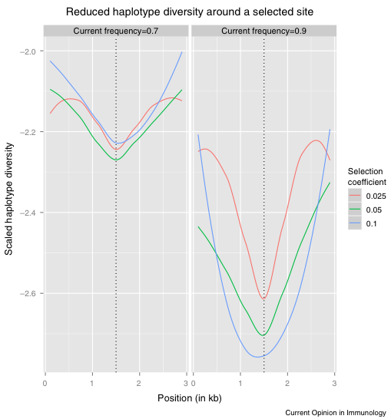
Haplotype diversity under selection
Reduction of polymorphisms
Decay of haplotype diversity is proportional to selective strength
Recombination breaks the signal
The effect is stronger in proximity of the selected site
Fumagalli and Sironi. 2014

Slide 90
Extended Haplotype Homozygosity
t>>T_{sel}
…
t>>>T_{sel}
…
Notes:
In practise it is more complicated due to mutation….

Slide 91
Extended Haplotype Homozygosity
t>>T_{sel}
…
t>>>T_{sel}
…
t>>>T_{sel}
Notes:
…and recombination.
For instance, if just looking at Theta W we might get the same value as for neutrality (6 SNPs)

Slide 92
Extended Haplotype Homozygosity
1
1
1
1
1
0
Core haplotype is 1
(Biallelic: 0 is ancestral, 1 is derived allele)
Core SNP
Notes:
…and recombination.
For instance, if just looking at Theta W we might get the same value as for neutrality (6 SNPs)

Slide 93
Extended Haplotype Homozygosity
1
1
1
1
1
0
Core haplotype is 1
(Biallelic: 0 is ancestral, 1 is derived allele)
Until marker x_{i}
(starting from x₀)
Notes:
…and recombination.
For instance, if just looking at Theta W we might get the same value as for neutrality (6 SNPs)

Slide 94
Extended Haplotype Homozygosity
1
1
1
1
1
0
Core haplotype is 1
(Biallelic: 0 is ancestral, 1 is derived allele)
Sum across all unique haplotypes carrying the core SNP
Notes:
…and recombination.
For instance, if just looking at Theta W we might get the same value as for neutrality (6 SNPs)

Slide 95
Extended Haplotype Homozygosity
1
1
1
1
1
0
Core haplotype is 1
(Biallelic: 0 is ancestral, 1 is derived allele)
n_{h} is haplotype frequency of h
n_{h} is haplotype frequency of the core SNP
Sum across all unique haplotypes carrying the core SNP
Notes:
…and recombination.
For instance, if just looking at Theta W we might get the same value as for neutrality (6 SNPs)

Slide 96
Extended Haplotype Homozygosity
1
1
1
1
1
0
Core haplotype is 1
(Biallelic: 0 is ancestral, 1 is derived allele)
n_{h} is haplotype frequency of h
n_{h} is haplotype frequency of the core SNP
Sum across all unique haplotypes carrying the core SNP
Notes:
…and recombination.
For instance, if just looking at Theta W we might get the same value as for neutrality (6 SNPs)

Slide 97
Extended Haplotype Homozygosity
1
1
1
1
1
0
Core haplotype is 1
(Biallelic: 0 is ancestral, 1 is derived allele)
n_{h} is haplotype frequency of h
n_{c} is haplotype frequency of the core SNP
Sum across all unique haplotypes carrying the core SNP
Notes:
…and recombination.
For instance, if just looking at Theta W we might get the same value as for neutrality (6 SNPs)

Slide 98
Extended Haplotype Homozygosity
1
1
1
1
1
1
1
1
1
0
0
0
x=0
x=+1
1
0
How many unique haplotypes carrying the core SNP?
What is their frequency?
Notes:
…and recombination.
For instance, if just looking at Theta W we might get the same value as for neutrality (6 SNPs)

Slide 99
Extended Haplotype Homozygosity
1
1
1
1
1
1
1
1
1
0
0
0
x=0
x=+1
1
0
Notes:
…and recombination.
For instance, if just looking at Theta W we might get the same value as for neutrality (6 SNPs)

Slide 100
Extended Haplotype Homozygosity
1
1
1
1
1
1
1
1
1
1
1
1
1
0
0
0
0
0
x=0
x=+1
x=+2
1
0
Notes:
…and recombination.
For instance, if just looking at Theta W we might get the same value as for neutrality (6 SNPs)

Slide 101
Extended Haplotype Homozygosity
1
1
1
1
1
1
1
1
1
1
1
1
1
0
0
0
0
0
x=0
x=+1
x=+2
1
0
Notes:
…and recombination.
For instance, if just looking at Theta W we might get the same value as for neutrality (6 SNPs)

Slide 102
Extended Haplotype Homozygosity
1
1
1
1
1
1
1
0
1
1
1
0
1
1
1
1
1
0
0
0
0
0
0
0
x=0
x=+1
x=+2
x=+3
1
0
How many unique haplotypes carrying the core SNP?
What is their frequency?
Notes:
…and recombination.
For instance, if just looking at Theta W we might get the same value as for neutrality (6 SNPs)

Slide 103
Extended Haplotype Homozygosity
1
1
1
1
1
1
1
0
1
1
1
0
1
1
1
1
1
0
0
0
0
0
0
0
x=0
x=+1
x=+2
x=+3
1
0
How many unique haplotypes carrying the core SNP?
What is their frequency?
1111 with freq=2
1110 with freq=2
1000 with freq=1
Notes:
…and recombination.
For instance, if just looking at Theta W we might get the same value as for neutrality (6 SNPs)

Slide 104
Extended Haplotype Homozygosity
1
1
1
1
1
1
1
0
1
1
1
0
1
1
1
1
1
0
0
0
0
0
0
0
x=0
x=+1
x=+2
x=+3
1
0
How many unique haplotypes carrying the core SNP?
What is their frequency?
1111 with freq=2
1110 with freq=2
1000 with freq=1
Notes:
…and recombination.
For instance, if just looking at Theta W we might get the same value as for neutrality (6 SNPs)

Slide 105
Extended Haplotype Homozygosity
1
1
1
1
1
1
0
0
1
1
1
0
0
1
1
1
1
0
1
1
1
1
1
1
1
0
1
0
0
0
0
1
0
0
0
0
x=-2
x=-1
x=0
x=+1
x=+2
x=+3
n | n choose 2
1 | 0
2 | 1
3 | 3
4 | 6
5 | 10
6 | 15
1
0
Comment on differences (if any) between EHH(x=+2) and EHH(x=-2).
Notes:
…and recombination.
For instance, if just looking at Theta W we might get the same value as for neutrality (6 SNPs)

Slide 106
Extended Haplotype Homozygosity
1
1
1
1
1
1
0
0
1
1
1
0
0
1
1
1
1
0
1
1
1
1
1
1
1
0
1
0
0
0
0
1
0
0
0
0
x=-2
x=-1
x=0
x=+1
x=+2
x=+3
n | n choose 2
1 | 0
2 | 1
3 | 3
4 | 6
5 | 10
6 | 15
1
0
Comment on differences (if any) between EHH(x=+2) and EHH(x=-2)?
Notes:
Rather than actual values of EHH, the decay (against physical of genetic map) is the important feature

Slide 107
Integrated Haplotype Score
1
1
1
1
1
1
0
0
1
1
1
0
0
1
1
1
1
0
1
1
1
1
1
1
1
0
1
0
0
0
0
1
0
0
0
0
x=-2
x=-1
x=0
x=+1
x=+2
x=+3
1
For the derived allele
0
cM
1
For the ancestral allele
0
cM
Notes:
Rather than actual values of EHH, the decay (against physical of genetic map) is the important feature

Slide 108
Integrated Haplotype Score
1
1
1
1
1
1
0
0
1
1
1
0
0
1
1
1
1
0
1
1
1
1
1
1
1
0
1
0
0
0
0
1
0
0
0
0
x=-2
x=-1
x=0
x=+1
x=+2
x=+3
1
iHH₁
Integrated haplotype homozygosity (iHH)
0
cM
1
iHH₀
0
cM
Notes:
Rather than actual values of EHH, the decay (against physical of genetic map) is the important feature
iHS compares the area under the curve defined by EHH for the derived and ancestral variants as one travels further in genetic distance from the core region
cross-population extended haplotype homozygosity (XP-EHH) compares haplotype lengths between populations.

Slide 109
Integrated Haplotype Score
1
1
1
1
1
1
0
0
1
1
1
0
0
1
1
1
1
0
1
1
1
1
1
1
1
0
1
0
0
0
0
1
0
0
0
0
x=-2
x=-1
x=0
x=+1
x=+2
x=+3
1
iHH₁
Integrated haplotype homozygosity (iHH)
0
cM
1
iHH₀
0
cM
Integrated haplotype score:
iHs = ln(iHH₁/iHH₀)
Genome-wide normalization in frequency bins
(to mean=0 and sd=1)
Notes:
Rather than actual values of EHH, the decay (against physical of genetic map) is the important feature

Slide 110
nSL
1
1
1
1
1
1
0
0
1
1
1
0
0
1
1
1
1
0
1
1
1
1
1
1
1
0
1
0
0
0
0
1
0
0
0
0
x=-2
x=-1
x=0
x=+1
x=+2
x=+3
1
~SL₁
Integration with respect to physical (not genetic) map
0
bp
1
~SL₀
0
bp
nSL= ln(SL₁/SL₀)
Genome-wide normalization in frequency bins
(to mean=0 and sd=1)
Notes:
Rather than actual values of EHH, the decay (against physical of genetic map) is the important feature

Slide 111
Cross-population
Extended Haplotype Homozygosity
1
1
1
1
1
1
0
0
1
1
1
0
0
1
1
1
1
0
1
1
1
1
1
1
1
0
1
0
0
0
0
1
0
0
0
0
x=-2
x=-1
x=0
x=+1
x=+2
x=+3
1
iHH_{A}
Integrated haplotype homozygosity (iHH)
for populations A and B
0
cM
1
iHH_{B}
0
cM
Integrated haplotype score:
XP-EHH = ln(iHH_{A}/iHH_{B})
Genome-wide normalization in frequency bins
(to mean=0 and sd=1)
Notes:
Rather than actual values of EHH, the decay (against physical of genetic map) is the important feature

Slide 112
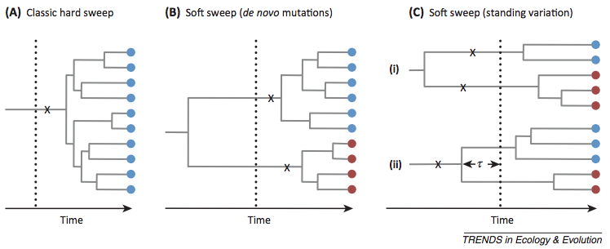
Hard sweep vs. Soft sweep
Hard sweep:
All adaptive alleles (in blue) arise from a single mutation (x) after the onset of the selective pressure (dotted line)
Messer and Petrov. 2013
Notes:
Here, easy to pick, haplotype homozygosity

Slide 113
Hard sweep vs. Soft sweep
Soft sweep from de novo mutations:
Adaptive alleles arise from different mutations (x) after the onset of the selective pressure (dotted line)
Messer and Petrov. 2013
Notes:
More than one common haplotype

Slide 114
Hard sweep vs. Soft sweep
Soft sweep from standing variation:
Adaptive alleles were already present at the onset of selection, from independent mutations (i) or from a single mutation event (ii).
Messer and Petrov. 2013
Notes:
More than one common haplotype

Slide 115
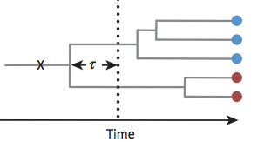
Detecting soft sweeps
Selection from standing variation allows for rapid adaptation and it may be a widespread from of selection. However, selection signatures are more cryptic.
More than one haplotype increases in frequency

Slide 116
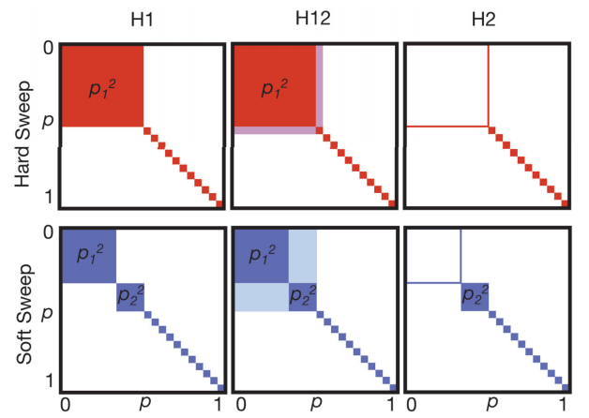
Detecting soft sweeps
Hard Sweep
Soft Sweep
Garud et al. PLoS Genetics 2015

Slide 117
Detecting soft sweeps
Hard Sweep
Soft Sweep
How to differentiate between hard and soft sweep? H2/H1
Garud et al. PLoS Genetics 2015

Slide 118
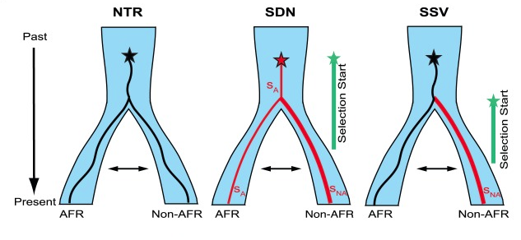
Detecting soft sweeps
Approximate Bayesian Computation (ABC): possibility to simulate and test very complex models
Also very attractive to estimate time and strength of selection under complex models.
Key et al. PLoS Genetics 2014

Slide 119
Outline
Brief introduction to natural selection
Modes of selection
Inferring selection at the intra-species level
Genetic differentiation
Haplotype variation
Model-based approaches
Testing for significance
Inferring selection at the inter-species level
Detecting selection from low-depth sequencing data

Slide 120

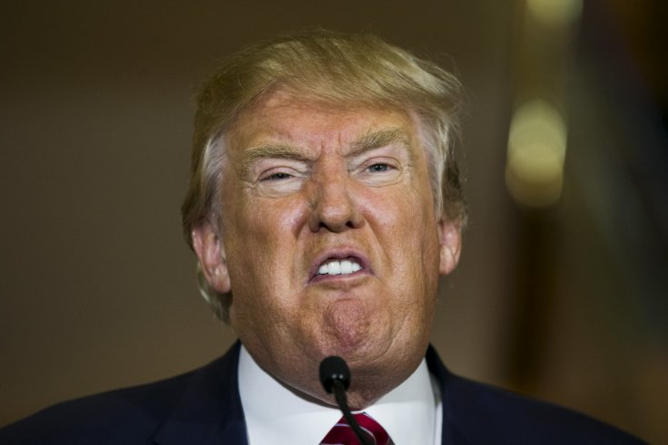
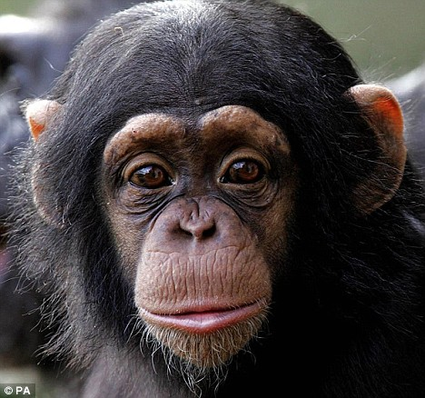
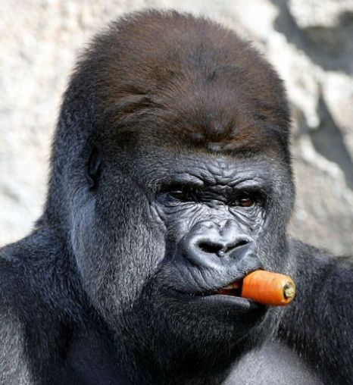
Inter-species variation
Inter-species
Intra-species
events in the deep past, macro-evolutionary trends, selection between species
Notes:
These changes typically occur at a longer time-scale.
Why is there the need of using different tools to detect selection at the inter-species level?
Let’s see a case study to understand why we need different methods in this case.

Slide 121
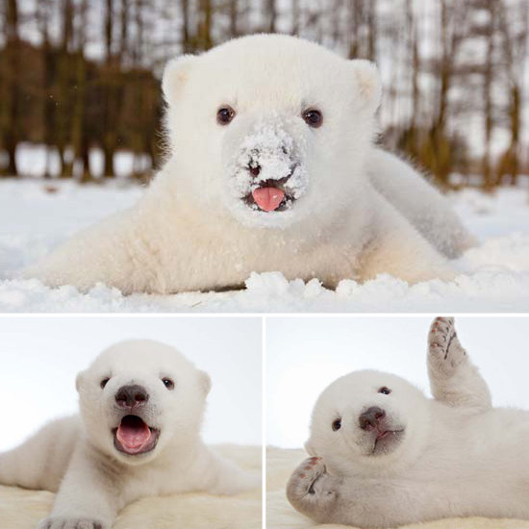
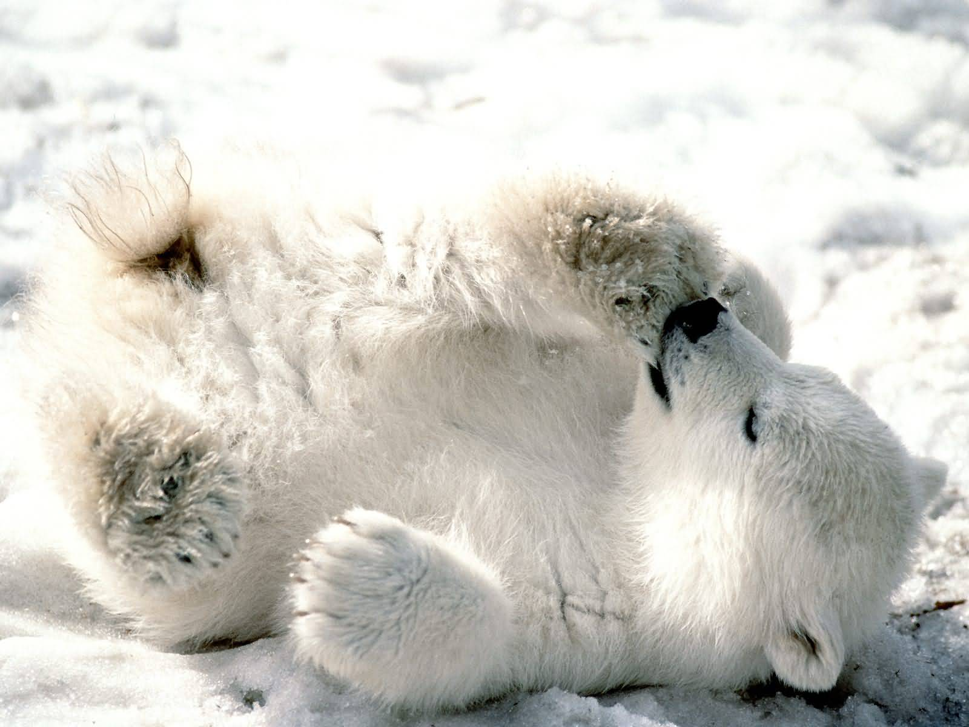
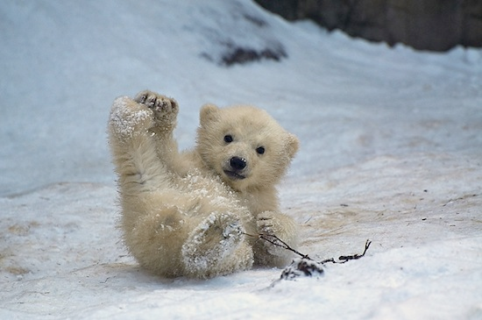
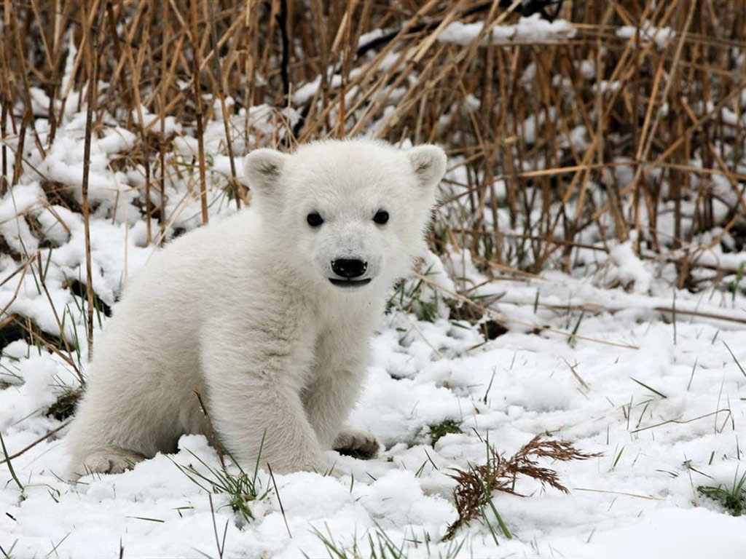
Polar bears!

Slide 122
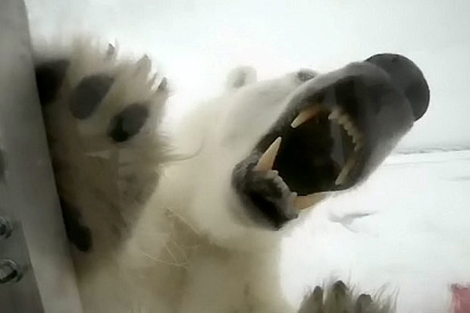
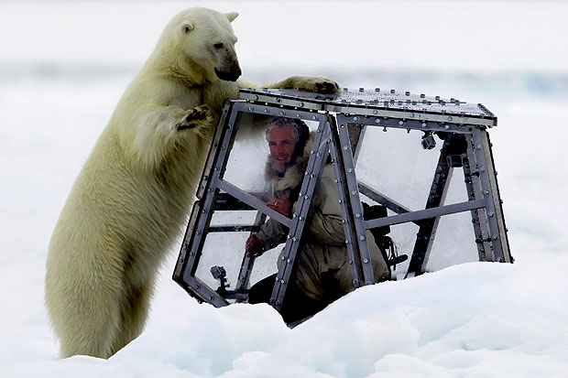
Polar bears!
http://www.gordonbuchananwildlife.com

Slide 123
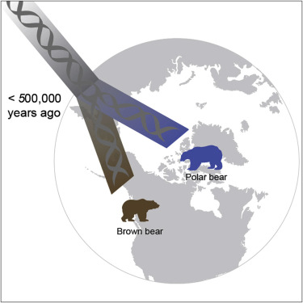
Polar bears vs. Brown bears
Question: what are the genetic signatures of polar bears’ adaptation to the Arctic environment?
Notes:
Why should we care about polar bears? Polar bears are an iconic species in evolutionary biology. Despite their relatively recent divergence from brown bears, they completely differ in their physiology, ecology and behavior suggesting a rapid evolutionary adaptation.
What is the first thing to do? Go there and collect samples.

Slide 124
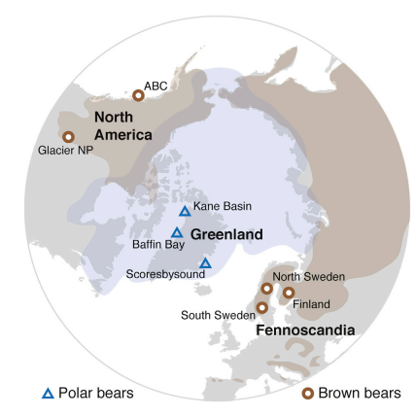
Experimental design
Almost 100 samples of brown and polar bears
Notes:
You go there and if you survive the cold and polar bears’ attacks, now we have access to all these samples.
What is the next thing to do? Sequencing them.

Slide 125

Sequencing experiment
Almost 100 samples of brown and polar bears
Very high-depth de novo assembled reference sequence (100X)
Whole-genome sequencing (30 at high-depth)
Notes:
Either you have the money or you find someone with the money and sequence them.
We have a reference sequence and whole-genome data.
What is the next thing to do? Do we have any idea of the shared evolutionary history between polar bears and brown bears?

Slide 126
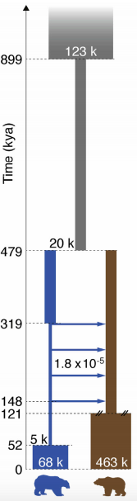
Demographic history
Divergence time of around 500k years ago
Reduction in population size in polar bears
Ancient gene flow
Recent population recovery (?)
Notes:
Yes. Assume we have already estimated a demographic model for the evolution of polar and brown bears.
So are we ready to go? What should we do next? Let’s perform a genome-wide scan for selection.
We are specifically interested in the genetic basis of what makes polar bears differ from brown bears?
Which test or tests would be more appropriate in this case? Like FST?

Slide 127
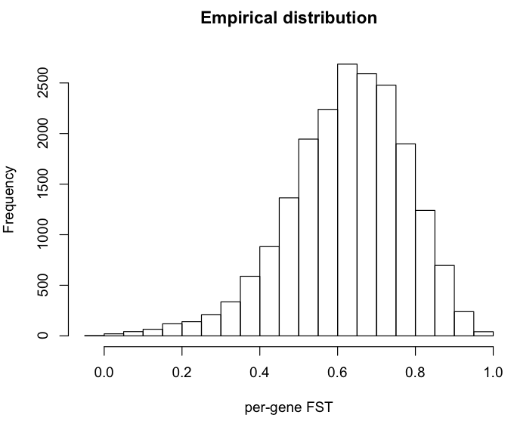
Expected genetic differentiation
Notes:
Under this demographic model the expected distribution of the FST values is this one.
As you can see, this distribution is very skewed towards high values.

Slide 128
Expected genetic differentiation
P(FST>0.7)=0.33
Notes:
For instance high values of FST, like 0.7 would be largely expected by simply neutral evolution with this model.

Slide 129
Expected genetic differentiation
P(FST>0.8)=0.11
Notes:
For instance high values of FST, like 0.8 would be largely expected by simply neutral evolution with this model.
And indeed the empirical distribution of FST in genes in this data set reflects this observation.
Many genes have very high FST. So by using only FST (so allele frequency differentiation) we cannot completely rule out whether selection or drift was responsible for driving this differentiation (and fixation).
We therefore need to implement a different text.

Slide 130
Inferring inter-species selection
Inter-species
Fixed substitutions
Polymorphisms
Intra-species
Notes:
Polymorphism levels depends on local mutation rates: under neutral evolution, the amount of within- and between-species diversity is expected to be similar across all loci in the genome.

Slide 131
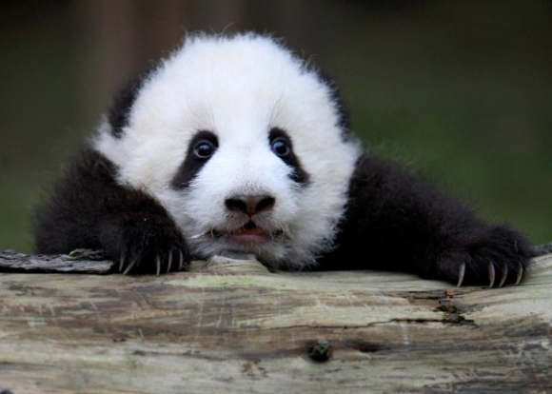
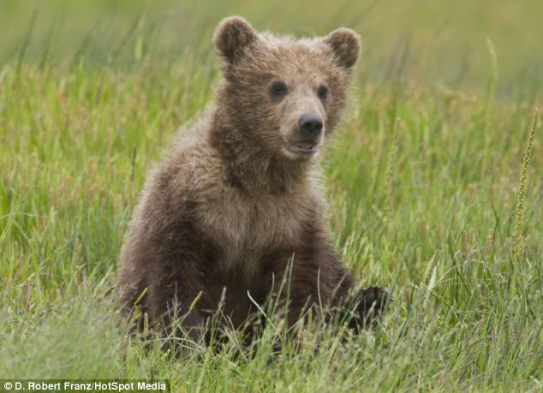

Polymorphisms and divergence
As both depend on mutation rates, and levels are expected to be proportional.

Slide 132
Polymorphisms and divergence
Under neutrality
(control locus or genome-wide)
≈
?

Slide 133
Polymorphisms and divergence
Under neutrality
(control locus or genome-wide)
≈
??? selection
>

Slide 134
Polymorphisms and divergence
Under neutrality
(control locus or genome-wide)
≈
Positive selection
(or negative selection)
>

Slide 135
Polymorphisms and divergence
Under neutrality
(control locus or genome-wide)
≈
?

Slide 136
Polymorphisms and divergence
Under neutrality
(control locus or genome-wide)
≈
<

Slide 137
Polymorphisms and divergence
Under neutrality
(control locus or genome-wide)
≈
??? selection
<

Slide 138
Polymorphisms and divergence
Under neutrality
(control locus or genome-wide)
≈
Balancing selection
(or relaxation of functional constraints)
<

Slide 139

HKA test
Hudson-Kreitman-Aguadè (HKA, Hudson et al. 1987) test
Contingency table 2x2: chi-square test
Under investigation
Control / Neutrally evolving

Slide 140

HKA test
Genes where divergence-to-polymorphisms ration was greater in brown bears

Slide 141

HKA test
Long tail

Slide 142

Coding polymorphisms
Substitutions in the coding regions may alter (non-synonymous) or not (synonymous) the protein sequence:
ATC CAA …
I Q
ATA GAA …
I K
ATG CAG …
M Q
Ancestral sequence
Species 1
Species 2
Non-synonymous
Synonymous
Notes:
Synonymous rate as baseline, considered as neutral evolving

Slide 143
dN/ds
Comparison between rate of nonsynonymous substitutions and rate of synonymous substitutions (also called K_{a}/K_{s} or ω)
Non-synonymous
Synonymous
Positive selection
(novel proteins)
K_{a}/K > 1
Negative selection
(against deleterious mutations
K_{a}/K <1
Notes:
Synonymous rate as baseline

Slide 144
Coding polymorphisms and divergence
Compare the amount of variation within a species to the divergence between species at non-synonymous and synonymous variants.
Non-synonymous
Synonymous
Substitutions
Polymorphisms
Notes:
Synonymous rate as baseline

Slide 145
MK (McDonald–Kreitman) test
Non-synonymous
Synonymous
Substitutions
Polymorphisms
Non-synonymous
Synonymous
Divergence
Polymorphisms
Notes:
Synonymous rate as baseline

Slide 146
MK (McDonald–Kreitman) test
Non-synonymous
Synonymous
Substitutions
Polymorphisms
Non-synonymous
Synonymous
Divergence
dN/dS between species
Polymorphisms
Notes:
Synonymous rate as baseline

Slide 147
MK (McDonald–Kreitman) test
Non-synonymous
Synonymous
Substitutions
Polymorphisms
Non-synonymous
Synonymous
Divergence
Polymorphisms
dN/dS withinspecies
Notes:
Synonymous rate as baseline

Slide 148
MK (McDonald–Kreitman) test
Non-synonymous
Synonymous
Substitutions
Polymorphisms
Non-synonymous
Synonymous
Divergence
2x2 contingency table
Polymorphisms
Notes:
Under neutrality, these rates should be equal.
If the between-species ratio exceeds the within-species ratio indicates positive selection between species (a larger within-species value suggests balancing selection or excess or weakly deleterious variants).

Slide 149


Comparative genomics
Identify multiple-species conserved genomic elements or accelerated rates of substitution in specific lineages (e.g. PAML software).
Forni et al. Plos Genetics 2014

Slide 150
Software available
DnaSP (http://www.ub.edu/dnasp/) Arlequin (http://cmpg.unibe.ch/software/arlequin35/)
BayeScan (http://cmpg.unibe.ch/software/BayeScan/)
libsequence (http://www.molpopgen.org/software.html)
sweep (http://www.broadinstitute.org/mpg/sweep/)
iHS (http://coruscant.itmat.upenn.edu/software.html)
nSL (http://cteg.berkeley.edu/~nielsen/resources/software/)
Pre-computed values (USCS genome browser tables)
Homemade scripts
…

Slide 151
Summary
Methods to detect signatures of selection are grouped based on:
time of selection
summary statistics used
Assessing statistical significance through empirical or expected distributions
Investigating complex models of selection and adaptation

